Slide 1
CIS 9440 -
Data Warehousing and Analytics
Class #2

Slide 2
Week 2 Class Overview:
Last Week Review
What is SQL?
Hands-on SQL Workshop

Slide 3
Week 2 Class Overview:
Last Week Review
What is SQL?
Hands-on SQL Workshop

Slide 4
What’s on Blackboard?
Slides of Class #1 on Blackboard
Getting Started with BigQuery resources
Final Project survey

Slide 5
Reading, BIG Chapter 8 all topics
Introduction to Data Modeling
Three levels of Data Models
Modeling workﬂow
Where data modeling is used
ER Modeling Overview (Referential Integrity)
Normalization

Slide 6
Reading, BIG Chapter 8 review topics
Introduction to Data Modeling
Three levels of Data Models
Modeling workﬂow
Where data modeling is used
ER Modeling Overview (Referential Integrity)
Normalization

Slide 7
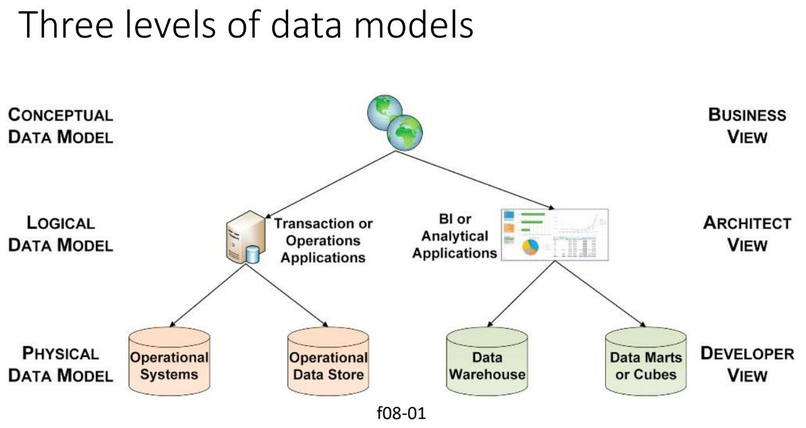

Slide 8
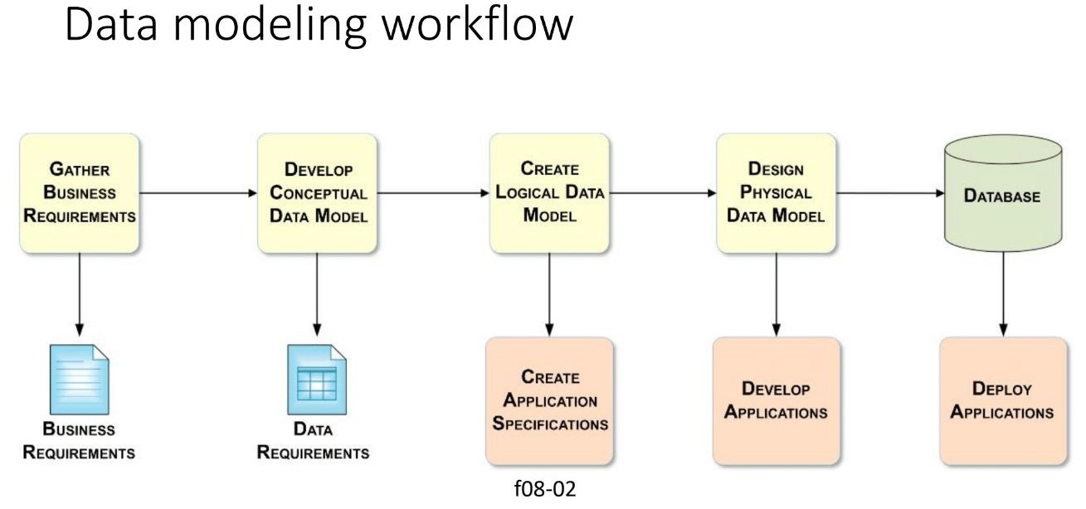

Slide 9
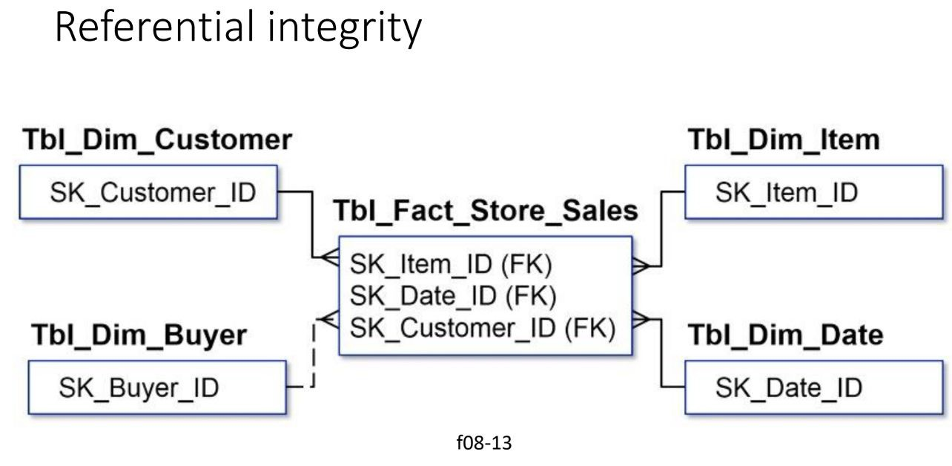
Referential Integrity (RI) includes enforcing relationship cardinality rules.
Example: if you have a one or many relationship you must have at least one non-null record
To enforce RI use foreign key constraints in your ETL process. This will guarantee RI for each insert, update, or delete in the database.

Slide 10
Week 2 Class Overview:
Last Week Review
What is SQL?
Hands-on SQL Workshop

Slide 11
What is SQL?
SQL (Structured Query Language) is the language used to communicate with a relational database (rows and columns).
It’s been the standard since 1987
It was created at IBM in the 70’s by Raymond Boyce and Donald Chamberlin.
- Do we always use relational databases?

Slide 12
What does SQL allow you to do?
SQL allows an Analyst to interact with an organization's data.
Insert new rows
Query the database for data
Delete rows
Change Permissions
etc.

Slide 13
Types of SQL Queries
There are 4 main types of SQL statements:
Type of SQL Statement | Purpose | Common Queries
Data Manipulation Language (DML) | Manage data within a table | SELECT, INSERT, UPDATE, DELETE
Data Deﬁnition Language (DDL) | Deﬁne database structure or table | CREATE, ALTER, DROP, RENAME
Transaction Control Statement (TCS) | Save permanent changes | COMMIT, ROLLBACK, SAVEPOINT
Data Control Language (DCL) | Give privileges to users | GRANT, REVOKE, AUDIT

Slide 14

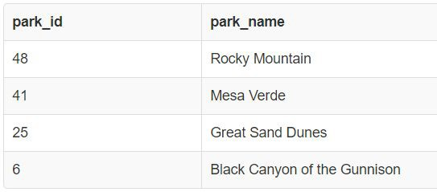
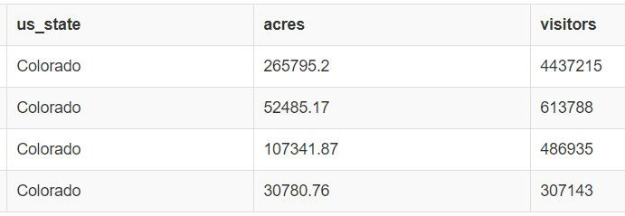
SQL, Common Example
Here, a user writes a simple SELECT query to view data from the table “Parks”
Intuitive!

Slide 15
Where is SQL in Data Warehousing?
SQL may appear in ETL/ELT during Data Integration
May be built into a recurring script
SQL can be used by Analysts to pull clean data from the BI Layer for custom/ad-hoc analyses
Even sometimes in BI Applications like “freeform MicroStrategy”

Slide 16
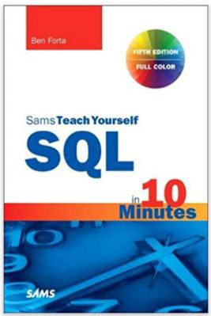
SQL Reference book for Analysts
Sams Teach Yourself SQL in 10 Minutes, by Ben Forta

Slide 17
Dialects of SQL
SQL has many versions. All versions are similar; if you know one you can learn all easily. But, different versions are referenced often so it’s valuable to know the differences:
SQL Server
MySQL
PostgreSQL
Sqlite
And many more

Slide 18
Week 2 Class Overview:
Last Week Review
What is SQL?
Hands-on SQL Workshop

Slide 19
Exercise: Practice SQL with BigQuery
(90 minutes)
Go to https://cloud.google.com/
If you do not yet have a BigQuery account, use the BigQuery sandbox: https://cloud.google.com/bigquery/docs/sandbox

Slide 20
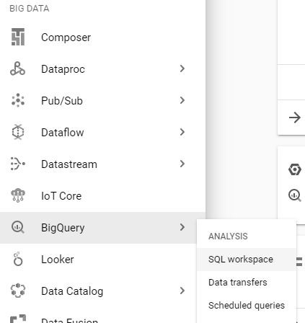
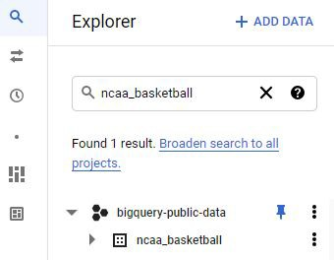
Click on “Go to console” button
On the left-most navigation pane, go to “BigQuery -> SQL workspace”
3.
4. In the search bar, type in “ncaa_basketball” and click enter

Slide 21
Practice SQL queries
Now, time to practice!
Please type out all following queries, try to avoid copy and paste

Slide 22
SQL tips for today:
SQL is very logical, so each query can be broken down into steps. Thus, break down each practice question and solve it step-by-step. No need to write the entire query at once.
Use semicolons to end each query
Use ALL CAPS for SQL keywords like SELECT
We will start very basic and ramp up to analytical SQL quickly, be patient!
SQL is not picky about white spaces, except during subqueries

Slide 23
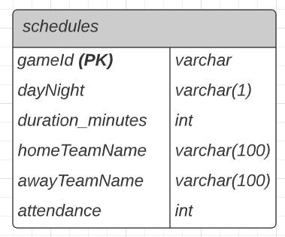
Data Model for ﬁrst examples
*Made with Lucidchart

Slide 24
SELECT *
Select all from a table
This will view all rows from table schedules
How many rows? What is the table size? Primary Key?

Slide 25
SELECT Column
Select speciﬁc columns from a table
Try 2 columns, then 3

Slide 26
LIMIT
Limit the number of rows returned by a query
*in other versions of SQL, you may use TOP rather than LIMIT

Slide 27
Add a Comment
Add a comment for users to read, not read by SQL

Slide 28
Add a Long Comment
Add a comment that is longer than 1 line

Slide 29
ORDER BY (sorting)
Order your query results in ascending or descending order by a speciﬁed column(s)

Slide 30
ORDER BY DESC (sorting)
Enter the following into the right-most window, then click “Run”:

Slide 31
ORDER BY + LIMIT (get top or bottom rows)
Get the top or bottom x amount of rows from a table

Slide 32
Practice Question 1:
(3 minutes)
Select the homeTeamName and attendance columns, order the query in descending by attendance , and limit the query to only 5 rows.

Slide 33
Practice Question 2:
(3 minutes)
In minutes, what was the longest game played?

Slide 34
Practice Question 3:
(3 minutes)
Which homeTeamName played a game with the lowest attendance?

Slide 35
DISTINCT
Return only the unique values from a speciﬁed row

Slide 36
COUNT
Count the number of rows in a SELECT statement
This will return the count of rows in the table

Slide 37
COUNT DISTINCT
Count the unique values in a speciﬁed column

Slide 38
WHERE (ﬁltering)
Filter based on a condition.

Slide 39
WHERE (ﬁltering)
Filter based on a greater than condition

Slide 40
Practice Question Set #1
Use keywords such as COUNT, DISTINCT, LIMIT, ORDER BY,
and WHERE to answer the following:
How many games had an attendance greater than 52,000?
What are the distinct dayNight values?
For only “D” games (night games), what are the 3 homeTeamName with the lowest duration_minutes?
How many homeTeamName have had at least 1 game with attendance > 49,000?

Slide 41


10 Minute Break
(7:30pm)

Slide 42
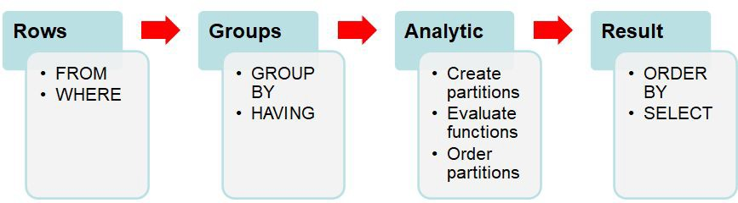
Query Clause Evaluation Order
SQL queries are run in a speciﬁc order:

Slide 43
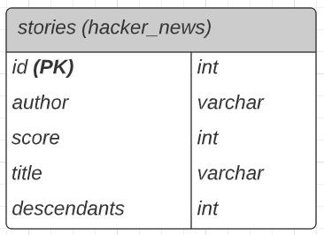
Data Model for next examples
*Made with Lucidchart

Slide 44
IN (ﬁltering)
Filter for only values in a speciﬁed list
View only markets where the venue is in New York or New Jersey

Slide 45
NOT IN (ﬁltering)
Filter for values not in a speciﬁed list

Slide 46
LIKE (wildcard ﬁltering)
Filter for values containing certain characters

Slide 47
Practice Question 4:
Select all distinct author names that contain the word queen

Slide 48
LENGTH
Find the length of a ﬁeld

Slide 49
Practice Question 5:
Select all title where the length of title is 10

Slide 50
Practice Question 5:
How many author have a length = 15?

Slide 51
Calculated Field
Create a new column based on a calculation

Slide 52
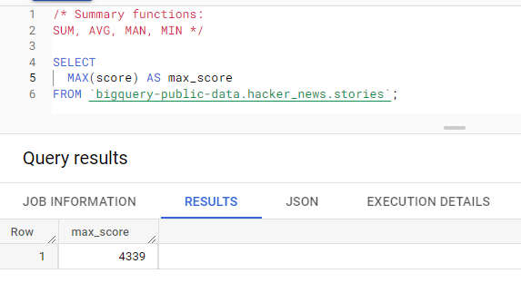
Summary Functions
Use SUM to get the sum of a table column

Slide 53
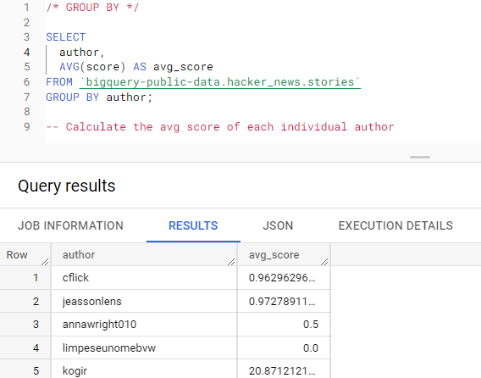
GROUP BY
If you want to group a summary function by a speciﬁc column(s)
How could we change this query to order by highest averages?

Slide 54
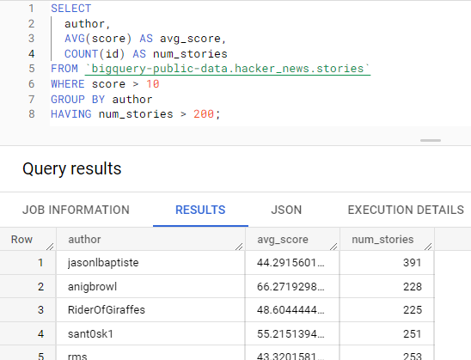
HAVING (WHERE for GROUP BY’s)
Use HAVING to apply a WHERE ﬁltered to GROUPED BY rows

Slide 55
Practice Question Set #2
Use keywords such as COUNT, DISTINCT, LIMIT, ORDER BY,
and WHERE to answer the following:
How many distinct titles are in the stories table?
Who is the author with the most total descendants?
How many titles contain the word “bigquery”?
How many authors have an average score > 12 and have at least 15 stories?

Slide 56
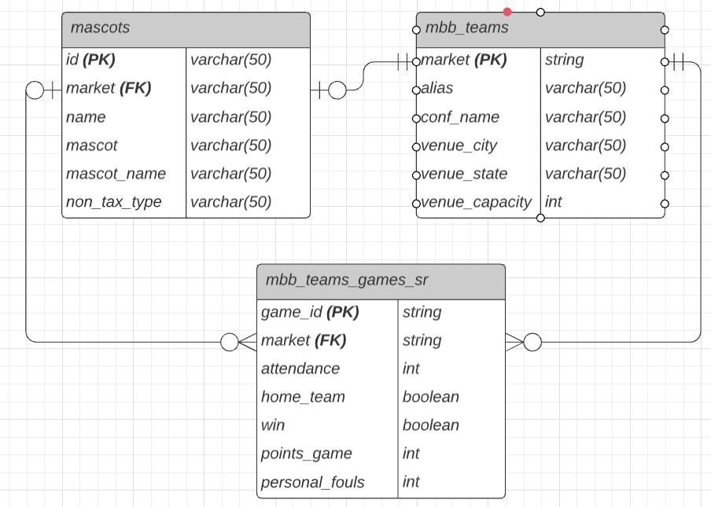
Data Model for today’s class
*Made with Lucidchart

Slide 57
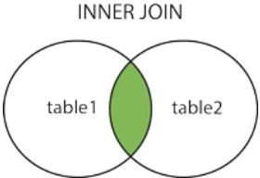
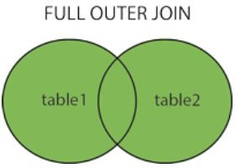
What is a JOIN in SQL?
We use a JOIN to query columns from multiple tables in SQL. We specify how we link a JOIN. For example, if we wanted information about a college from both the mascots and mbb_teams table, we could JOIN these tables on the college name.

Slide 58
Types of Joins
Inner Joins return records that have matching values in both tables.
Outer Joins return all records for both left and right tables.

Slide 59
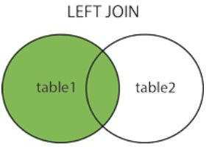
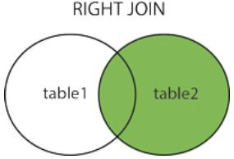
Types of Joins (continued)
Left Joins return all records from left table, and matching records from right table.
Right Joins return all records from right table, and matching records from left table.

Slide 60
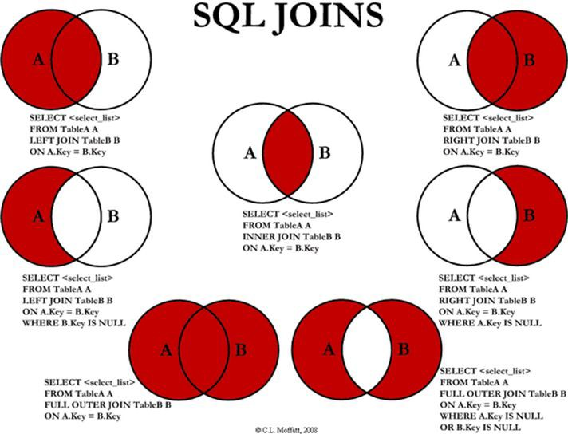
Joins Syntax (good to print)
Notice the “ON” statement in each JOIN.

Slide 61
JOIN
When you have multiple tables that have ﬁelds in common and you want to see attributes from both tables.
SELECT a.market,
a.mascot_name, b.conf_name
FROM `bigquery-public-data.ncaa_basketball.mascots` a JOIN `bigquery-public-data.ncaa_basketball.mbb_teams` b ON a.market = b.market;

Slide 62
JOIN (continued)
When you have multiple tables that have ﬁelds in common and you want to see attributes from both tables.
SELECT a.market,
a.mascot_name, b.conf_name
FROM `bigquery-public-data.ncaa_basketball.mascots` a JOIN `bigquery-public-data.ncaa_basketball.mbb_teams` b ON a.market = b.market
WHERE b.conf_name IN ("Ivy", "Big Sky") ORDER BY b.venue_capacity DESC;

Slide 63
JOIN (continued)
Top 5 teams and mascots with most total points scored
SELECT a.market,
a.mascot,
sum(b.points_game) total_points
FROM `bigquery-public-data.ncaa_basketball.mascots` a
JOIN `bigquery-public-data.ncaa_basketball.mbb_teams_games_sr` b ON a.market = b.market
GROUP BY a.market, a.mascot ORDER BY 3 DESC
LIMIT 5;

Slide 64
Practice Question 10:
(5 minutes)
Write a query that returns the market, mascot, and mascot_name from all colleges with conf_name equal to “Big 12”.

Slide 65
Practice Question Set #3
Use keywords such as COUNT, DISTINCT, LIMIT, ORDER BY, WHERE, IN, NOT IN, AND, OR, AVG,
SUM, MAX, GROUP BY, JOIN to answer the following:
(*Refer to the ER Diagram)
What is the market, mascot, and venue_state of the 5 teams with the largest venue_capacity?
Which conf_name had the most total wins?

Slide 66
CASE statement
Create an IF statement in SQL
SELECT market, venue_name,
CASE WHEN venue_capacity > 15000 THEN 'large arena' WHEN venue_capacity > 7500 THEN 'medium arena' ELSE 'small arena'
END AS arena_size
FROM `bigquery-public-data.ncaa_basketball.mbb_teams`

Slide 67
RANK
Rank the values of a column in a speciﬁed order
SELECT market,
RANK() OVER (ORDER BY SUM(personal_fouls) DESC) total_fouls_rank, SUM(personal_fouls) total_fouls
FROM `bigquery-public-data.ncaa_basketball.mbb_teams_games_sr` GROUP BY market
ORDER BY 2 ASC;
Rank the markets by total personal fouls

Slide 68
RANK (example 2)
SELECT market, conf_name,
RANK() OVER (PARTITION BY conf_name ORDER BY SUM(personal_fouls) DESC) conf_fouls_rank
FROM `bigquery-public-data.ncaa_basketball.mbb_teams_games_sr`
--WHERE conf_name IN ("Centennial Conference", "Big East") GROUP BY market, conf_name
ORDER BY 3 ASC;
Total Personal Fouls rank within the team’s conference

Slide 69
Practice Question 11:
(5 minutes)
Write a query that returns the scheduled_date, market, and a CASE statement that returns “Ejected player” if ejections > 0 and “No ejected player if ejections = 0 from the mbb_teams_games_sr table.

Slide 70
UNION ALL
Combine columns into a single column
https://chartio.com/resources/tutorials/how-to-union-queries-in-google-bigquery/#usi ng-the-union-option-in-standard-sql
SELECT market
FROM `bigquery-public-data.ncaa_basketball.mbb_teams` UNION ALL
SELECT mascot
FROM `bigquery-public-data.ncaa_basketball.mascots`

Slide 71
Subquery

Slide 72
INSERT
Enter the following into the right-most window, then click “Run”:
INSERT INTO parks
VALUES
(59, 'Baruch College', 32, 2, '1919-01-01');
SELECT * FROM parks;
Insert a new value into the Parks table

Slide 73
UPDATE
Enter the following into the right-most window, then click “Run”:
UPDATE Parks_Rating
SET rating = 5.0 WHERE park_id = 3;
SELECT * FROM Parks_Rating
Update a rating in the Parks_Rating table

Slide 74
DELETE
Enter the following into the right-most window, then click “Run”:
DELETE FROM Parks_Rating
WHERE tent_campers < 100;
SELECT * FROM Parks_Rating

Slide 75
CREATE VIEW
A view is a virtual table that dynamically retrieves data each time it is called.
CREATE VIEW `myproject.mydataset.top_3_points` AS SELECT market,
SUM(points_game)
FROM `bigquery-public-data.ncaa_basketball.mbb_teams_games_sr` ORDER BY 2 DESC
LIMIT 3;
SELECT * FROM `myproject.mydataset.top_3_points`

Slide 76
STORED PROCEDURE
A Stored Procedure is a prepared chunk of SQL code that you can save, and pass values into, so the code can be reused at any time with new values.
CREATE FUNCTION delete_parks_before (before_date DATE) LANGUAGE plpgsql
AS $$ BEGIN
DELETE FROM parks
WHERE founded < before_date; END;
$$;

Slide 77
Query Clause Evaluation Order
SQL queries are run in a speciﬁc order:

Slide 78
Practice Question Set #4
Use keywords such as COUNT, DISTINCT, LIMIT, ORDER BY, WHERE, IN, NOT IN, AND, OR, AVG, SUM, MAX, GROUP BY, JOIN, INSERT, DELTE, UPDATE, VIEW to answer the
following:
Rank the conferences with the highest average attendance during losses. Which conferences rank ﬁrst, second, and third?
Create a view to select the smallest 5 venue_capacity.

Slide 79
Homework:
Ensure your Google BigQuery account is setup
Homework #1 assigned on Blackboard
Final Project Survey on Blackboard in Class 1 folder
Reading BI Guidebook, Chapters 1 and 2

